Slide 1
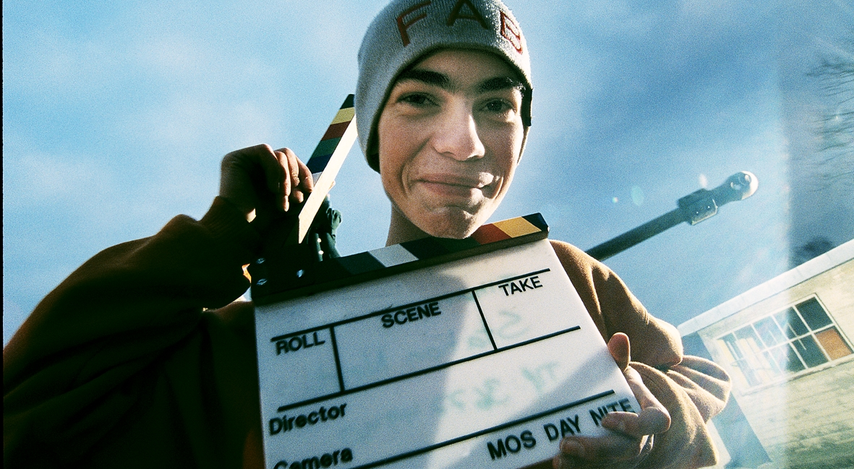


Dobry dzień
Susanne Wad
Film Studies Director
STATION NEXT
Start: 2000
Dziękuję za zaproszenie
Notes:
It is a great honour and joy to be here today
My name is Susanne Wad and I’m the Film Studies Director and one of the founding mothers of Station Next
My experience stems from my work at The National Innovative Centre for General Education and The Danish Film Institute.
– A film and media school based in Filmbyen outside Copenhagen and Aarhus.
We are a non-profit organization mainly funded by The Danish Ministry of Culture.
thank you so much for inviting me to share some of our experiences.

Slide 2
My presentation
How and why the initiative was started?
The pedagogical and film professional platform
Notes:
I’m very happy to tell you about how it all started and how we work
with young people and film

Slide 3
Station Next -Major Aims
To promote awareness of the production of film/media and media pedagogy in Denmark .
To give children and young people with different backgrounds the opportunity to understand and express themselves through film/ media.
To promote and stimulate active interaction between the education system and the whole film, television and multimedia industry and related areas.
To inspire towards giving media a higher priority in the education system.
Notes:
Understand and express themselves = production leads to analyses

Slide 4
Why?
motivation
media ”language”
many job functions
Notes:
I think film is the perfect media in the meeting with young people because:
1. Film is not just one subject matter but a combination of many professional competencies.
This offers the students the possibility of finding a job function that targets their competencies and interests.
And this enhances job opportunities
2. Film use the same “language” as many other types of media which makes it vital in acquiring media literacy
3. Film is a popular media with young people which give them the natural motivation for working with film

Slide 5
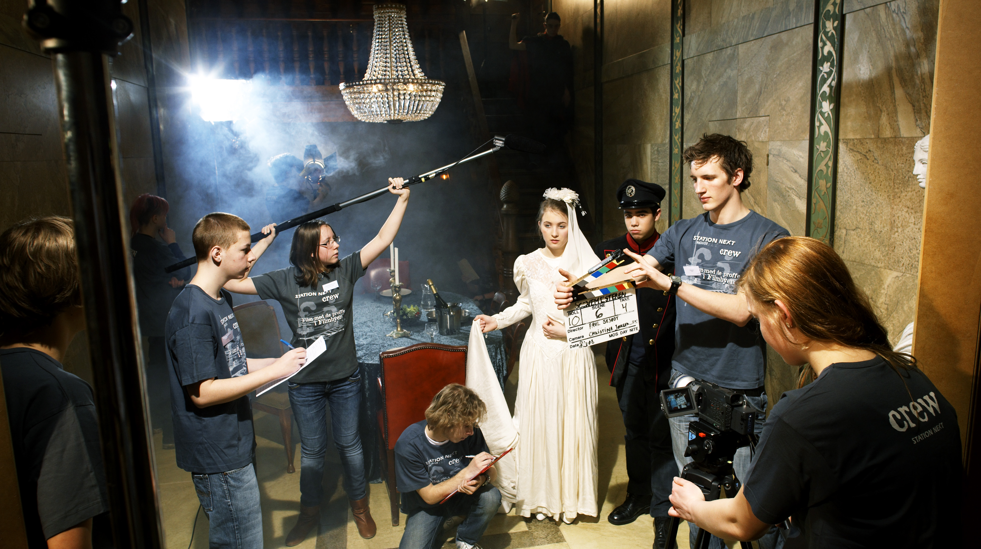
Why?
Lack of equipment and
time in schools
Lack of media studies
in teacher training
Complicated process
of Filmmaking
Between two stools
Notes:
We started Station Next in because
There was no film education in teacher training – this is still true –
so we looked to the film makers for the knowledge and skills
There was limited flexibility in the time table at school – so it was
easier to visit Station Next on a day course or a film camp
Lack of equipment and competencies in school – this situation has improved
within the last 14 years
Film education seemed to fall between two stools Culture and school.
So everybody talked about the importance of film and media in school
but no one felt resposible.

Slide 6
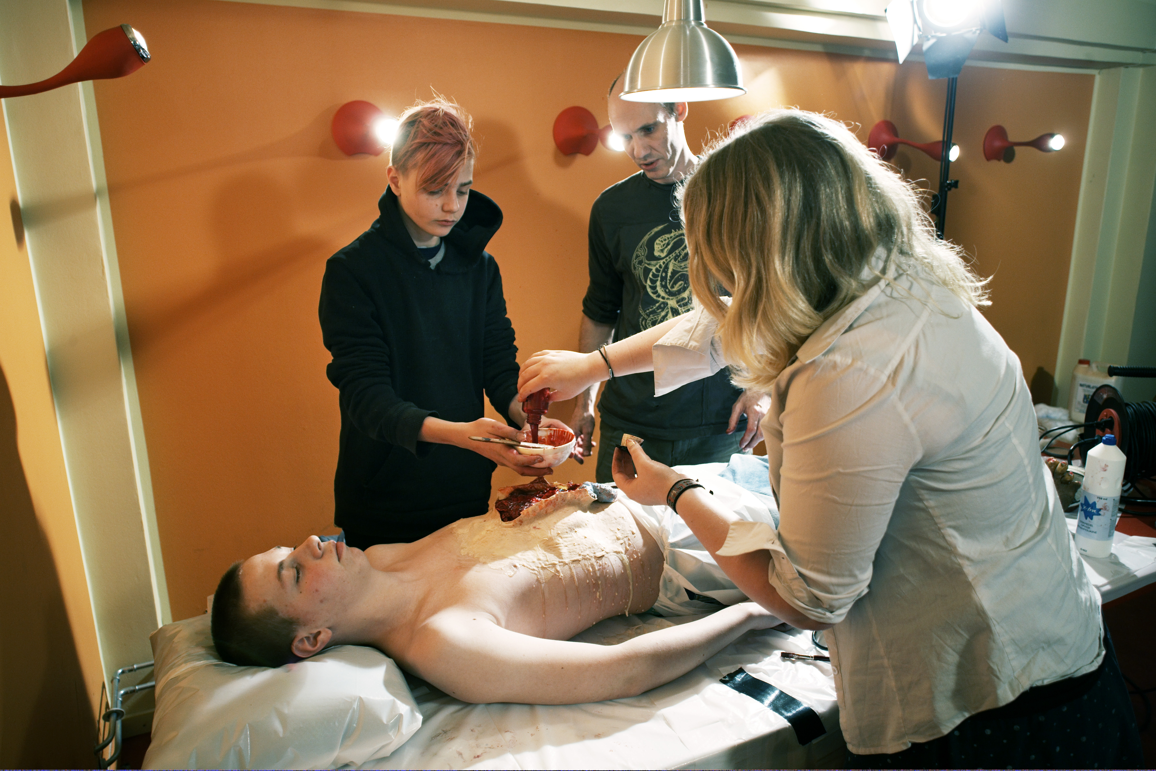
Why?
Technical qualifications
Esthetic qualifications
Communicative qualifications
Cooperative/social qualifications
Planning/logistic qualifications
Critical/democratic qualifications
Notes:
Working with film qualifies the students for many different kinds of jobs – and the qualifications
do not only apply in the film business
1 Communicative qualifications
2 Esthetic qualifications
3 Technical qualifications
4 Planning/logistic qualifications
5 Critical/democratic qualifications
6 Cooperative/social qualifications
All very useful in their education

Slide 7
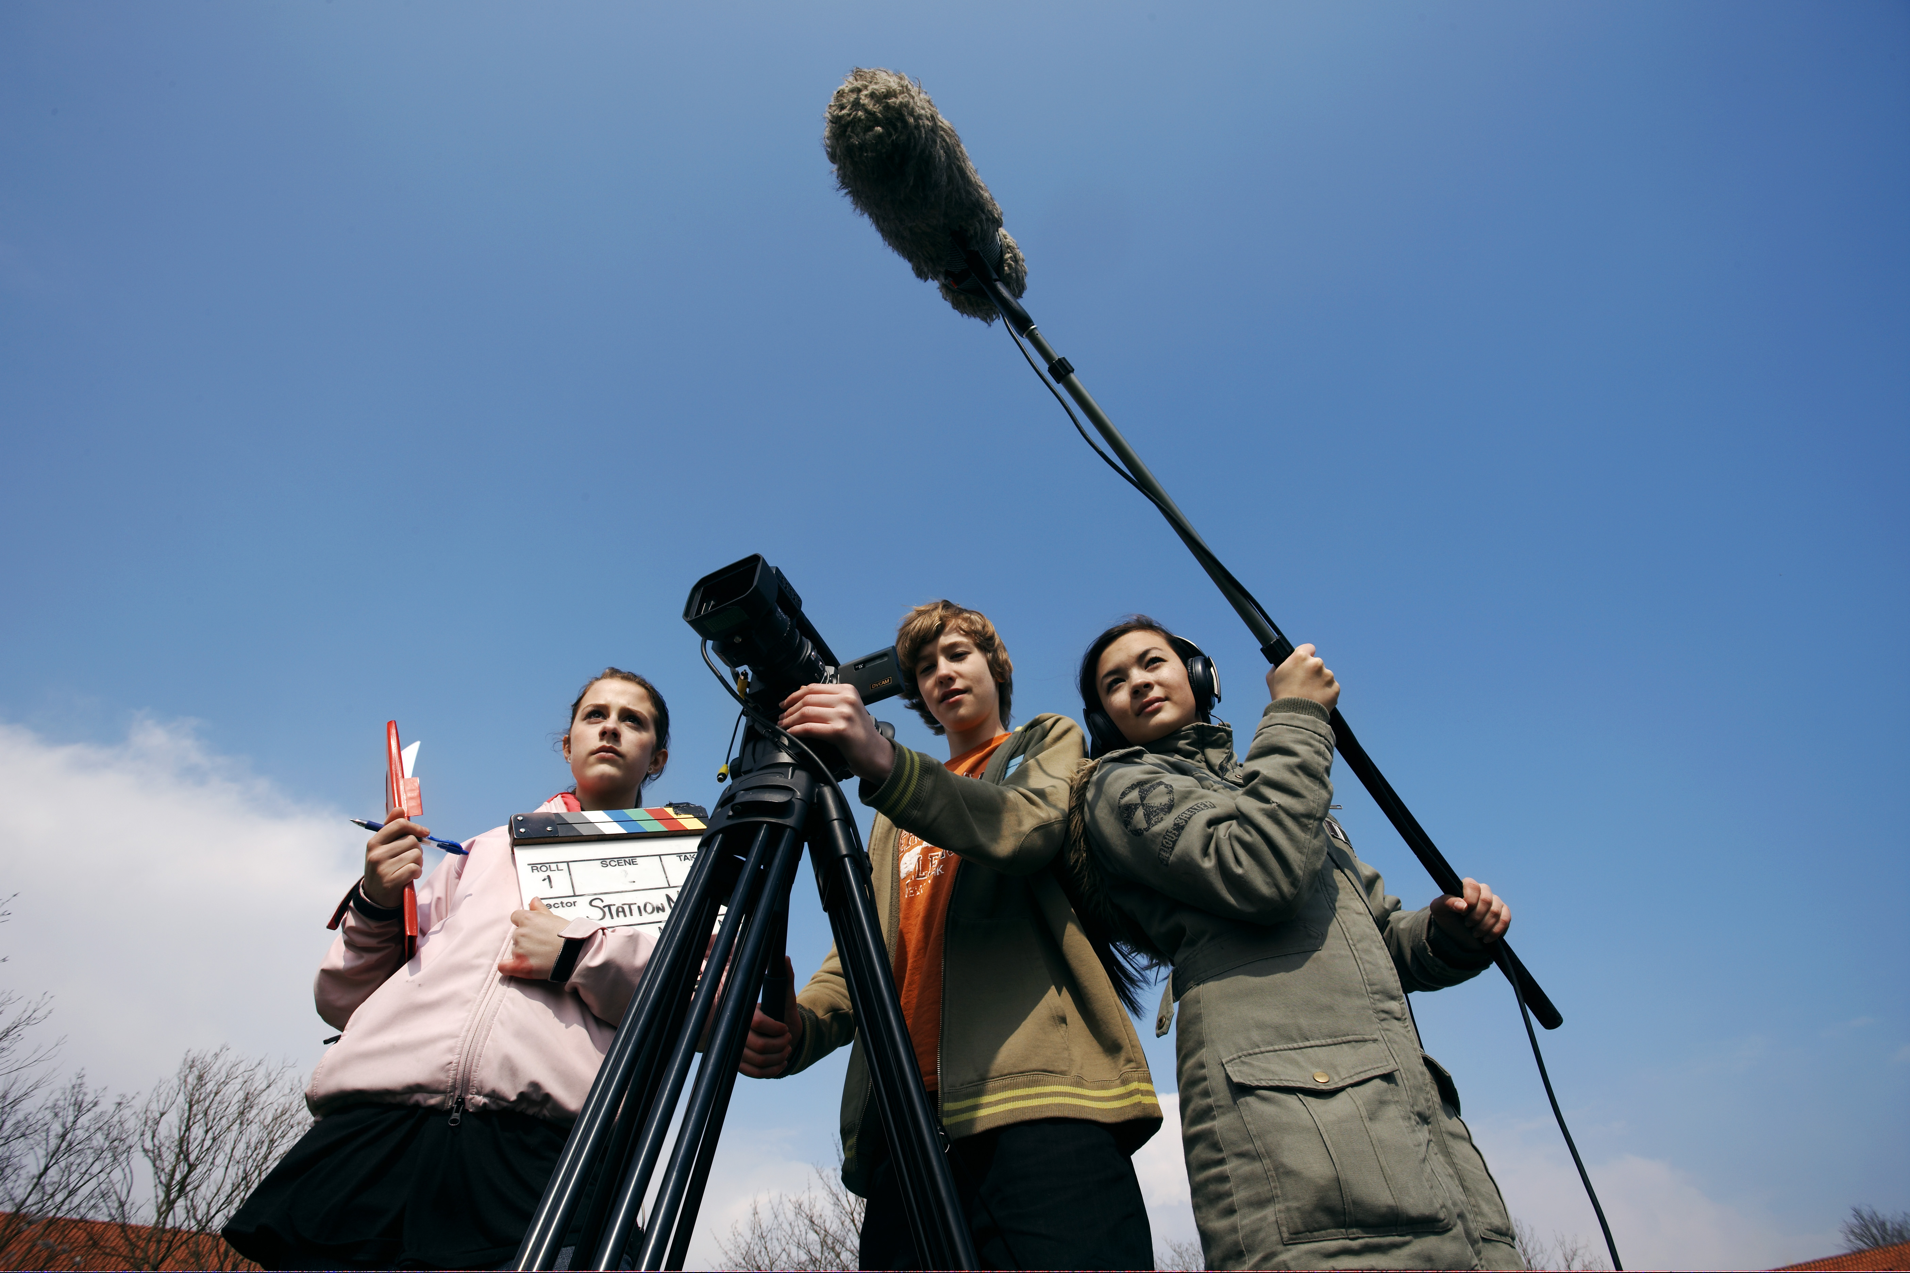
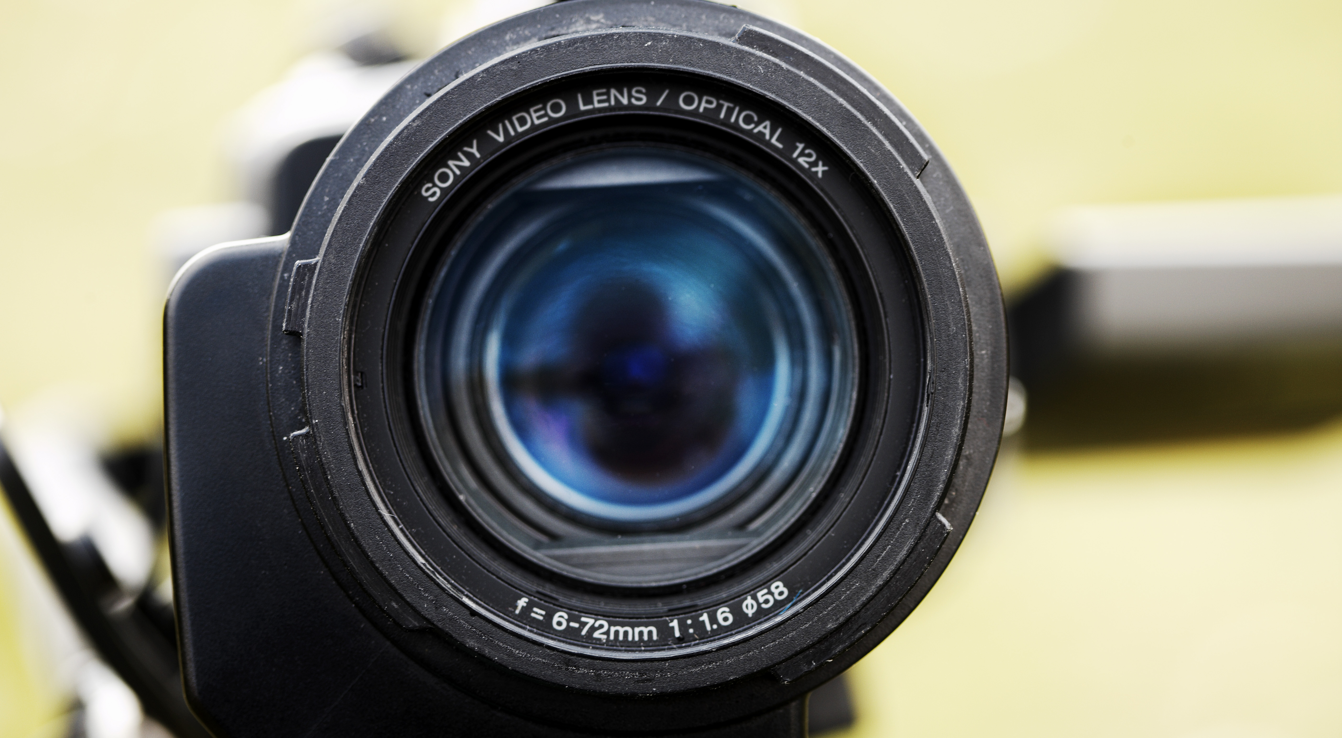
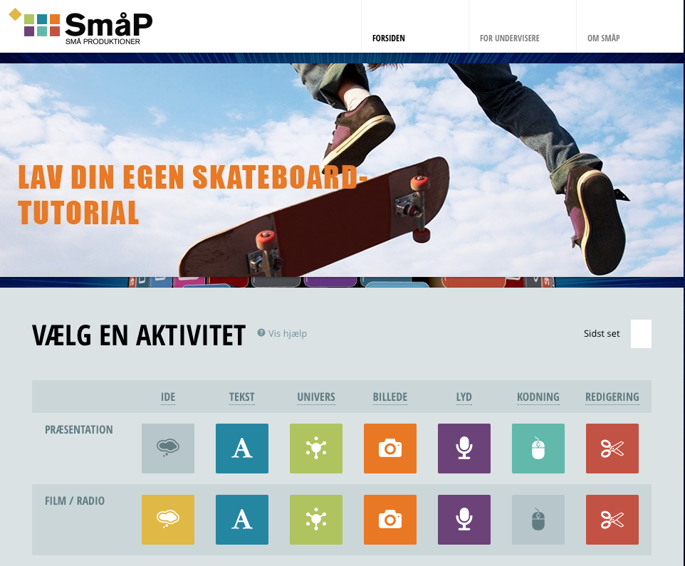
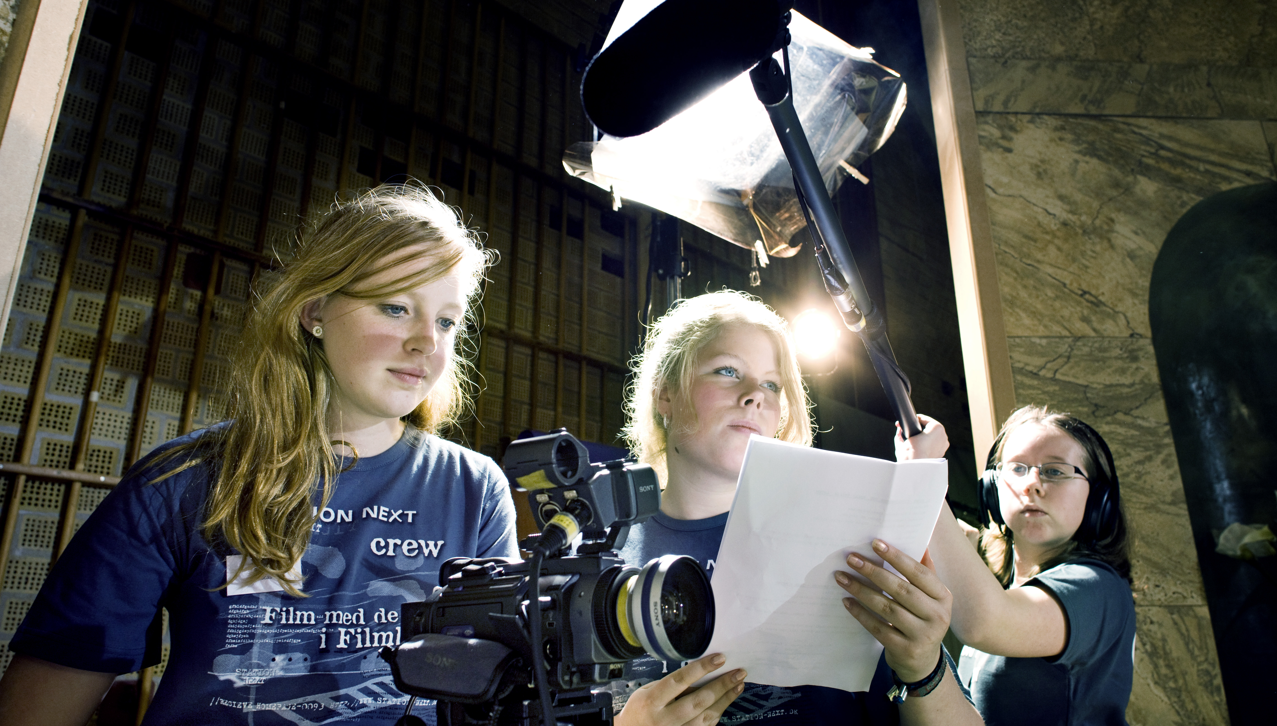

What?
FILM CAMPS
20 classes per year
SHORT COURSES
200 classes per year
FREE ONLINE
Teaching tools
GREENHOUSE
10 talent classes
Notes:
Station Next offers different activities for young people between 13 -18
Film camps: Where ordinary school classes stay for 1 week at Station Next and produce 1 film coached by professionals
The students go through an exemplary film production and the class experience an optimal working process.
Short courses: Where ordinary school classes visit Station Next 1 day: with 1 film professional , working with 1 subject matter.
Day courses cover ten different film subject areas e.g. scriptwriting, editing, cinematography, production planning,
Greenhouse: A 3 year talent development programme – where young people study film making after school.
Right now 9 former students are attending the National Film School
Online teaching tools: SN has produced these online teaching tools. I’ll get back to the SmåP site later

Slide 8
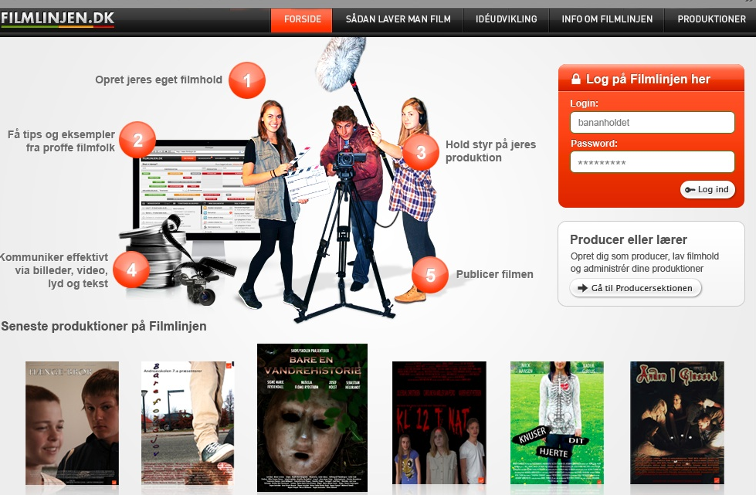
The Filmline
Notes:
The Filmline is used by our greenhouse students, the filmcamps and ordinary schools.
Here is a short presentation:

Slide 9
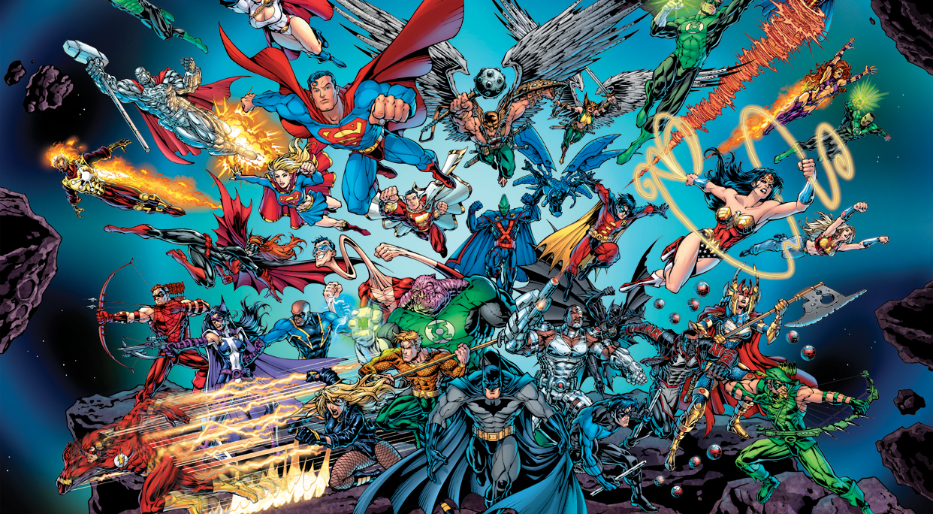
The initiative
Hvidovre Kommune
DR
TV 2 Danmark
Ungdomsbyen
Nordisk Film & TV
Danske Film- og TV- producenter
Danske Børne- og Ungdomsfilmklubber
Zentropa Aps
Notes:
In 1999 we started a pilot project and
right from the start we gathered possible stakeholders and
we got the support from a united pedagogical film- and media environment:
The video showing the film camp helped a lot!
1 Danish children and youth film clubs
2 The Danish Broadcasting Corporation
3 The Municipality of Hvidovre
4 The Youth Town – The National Innovative
Centre for General Education
5 TV2 Denmark
6 Nordisk Film & TV A/S
7 The Association of Danish Film and TV
Producers
8 Zentropa productions
We are very grateful for the support which is crucial for us

Slide 10
Station Next in figures
Turnover
2013: 9 mio. dkr
Government Grant: 5,6 mio. Dkr
Charges
Day courses per class: 850 dkr
Film camps per class: 25.000 dkr
Greenhouse: Free of charge supported
by continuation school
Educational websites: Free
Film professionals per year: app. 70
Student course days per year: 7500
2013 figures
Notes:
In 2013 we had a turnover of 9 mill dKr
We receive 5,6 mill dKr from the ministry of culture
Which enables us to keep down the prices so the schools
are able to profit from our courses
The Greenhouse is also supported by the relevant municipalities
Our websites are funded by grants so they are free of charge.
By the way Norway has bought both sites
Station Next is quite popular with the filmmakers and we have
variety of freelancers app 70 pr year

Slide 11
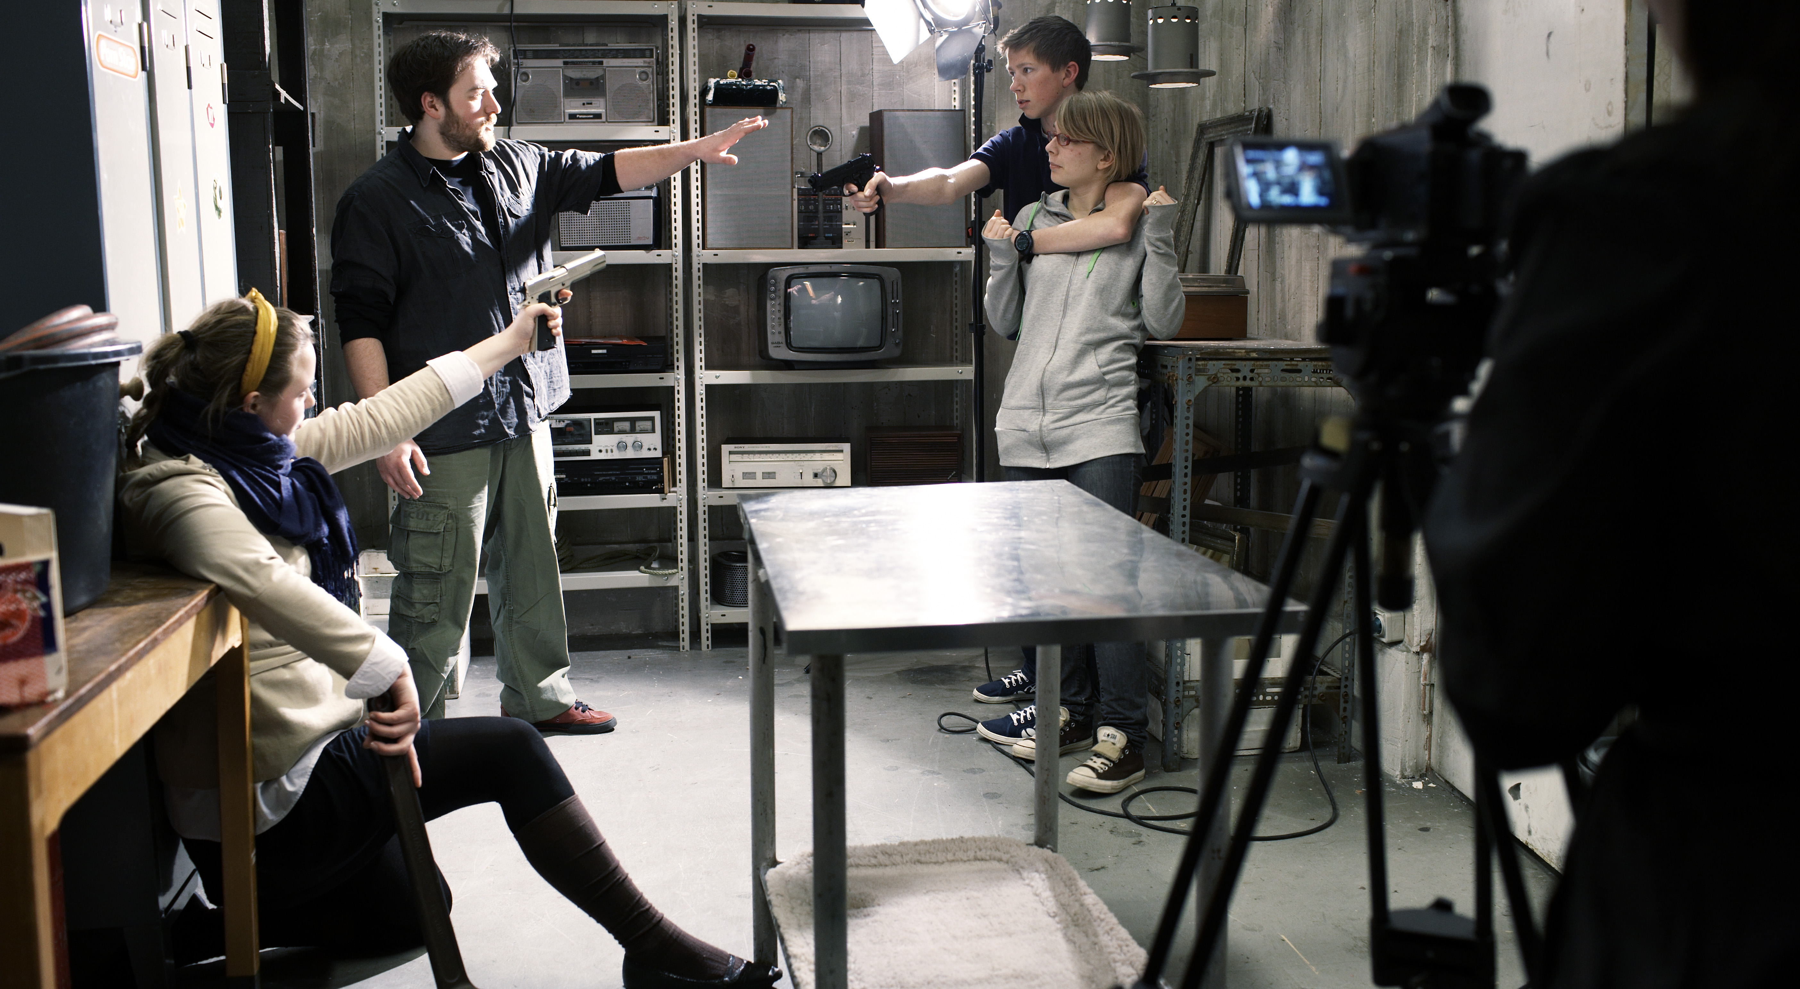
How?
i
material
filmmakers
methods
PROFESSIONAL
crew
equipment
Notes:
How:
An important feature about Station Next is our didactics
Our students are coached by film makers in a professional environment.
We have a professional studio with 11 different sets
And work like a professional film crew each crewmember has his/her own job
We use professional equipment or semi professional equipment
We use professional methods and materials eg. Moodboards for set design –
Floorplans for cinematography

Slide 12
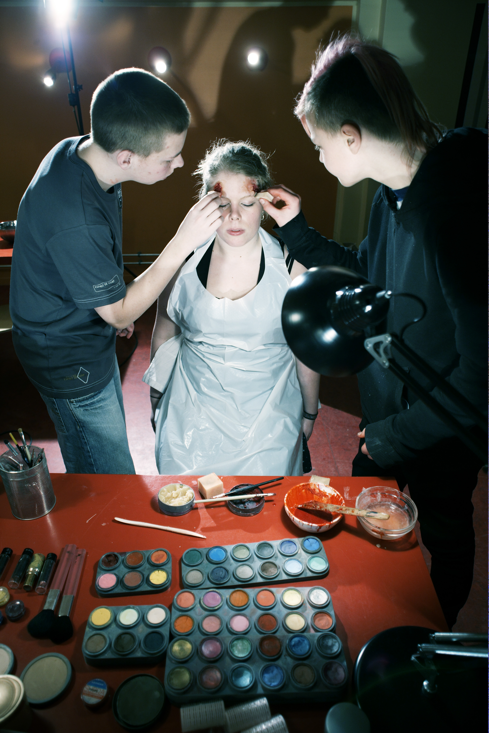
How?
Hands on!
Stand up!
Common
focus on the
product
Notes:
We want the kids to be active producers and that’s why we have two main pedagogical principles:
Hands on! Because we want the kids to focus on the product and work as a professional crew – coached by the film professionals
Stand up! Station Next doesn’t resemble a traditional school. The professionals work using our didactics but in their own style.
During production: they act like like a sports coach would: The profs don’t play the game/shoot the film, but suggests strategies that the kids may/may not use.
Sometimes the kids decline politely and it is great fun when the professionals admit the the kids solution was the better one
Common focus on the product results in an authentic process where students and film professionals meet on equal terms – in common dedication for film

Slide 13

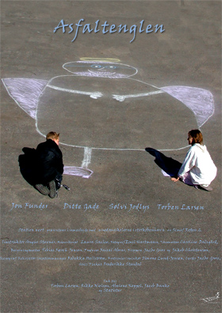


How?
From idea to poster
Notes:
The student are responsible for everything
They develop the Idea, write the manuscript, find locations, edit the film,
design posters and all the other tasks
Here you see some of the posters from the Greenhouse.
E.G It is a great experience for the designer to hang the big posters
When we have the big premiere in the largest cinema in Copenhagen

Slide 14
Talent
1. CREATIVE BOOTCAMP:
play/imagination/body/courage/common practice/socialization
2. EDUCATIONAL PROVOCATIONS:
leave their comfort zone/appropriate disturbance
3. AUTHENTICITY:
professional filmmakers/methods/equipment
4. PHYSICAL LEARNINGSPACES:
locations/non-school
5. THE FILM LINE/SmåP:
Online/community/school/leisure
Notes:
To develop our talents we use different teaching methods:
We start our Greenhouse be dragging the kids through a creative bootcamp where them are challenged in many ways
We provoke them to leave their comfort zone.
Nothing in our film production is make believe. This places an importance on each function and creates an authencity
This is results in mutual respect and determination
4. We also provide an authentic environment that signal film production and not school
- as some of our students aren´t great school fans
5. We use online teaching material because our students are online, it is a great way of building a community and it is completely
Independent of time and space.

Slide 15
Talent
6. COACHING:
individual potential/consciousness-raising/challenge/motivation
7. REMEDIATION:
traditional media/new media
8. MENTORSYSTEM:
dedication/common reference/industry contact
9. SHOWCASING:
gala premieres/festivals/web
10. COMMUNITY:
virtual/reality/peers/professionals/Station Next
Notes:
6. The Students are coached by the professionals. This enhances the kids’ individual potential
And raise their consciousness. We motivate and challenge the students to go new ways
7. We teach skills– old and new – to provide the students with bricks for remediation
And they certainly use their skills in many inventive ways
8. We provide the gifted students with a mentor so they can profit from their dedication and
get acquainted with the film industry
9. We place a great importance on showcasing students’ films which is highly motivating for
the kids
10. We provide an environment – both on line and in reality where the kids meet their class
mates, the film makers and the rest of the staff. So they may get the right support for their
development
from other classes

Slide 16
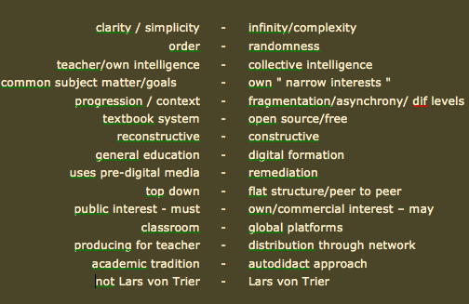
The pre-digital school - The world wide web
Notes:
At Station Next we of course know that the media is converging in
many ways. The internet does not only offer infinite possibilities but also
new ways of thinking.
Here you search information in the collective intelligence. You get
tools to construct your own products. You may overtake your big
brother – knowing stuff regardless of your.
But you need to be “Lars von Trier” so make yourself known on
the internet. You often hear: just give them an iPad and they can
do everything by themselves. But is this really true

Slide 17
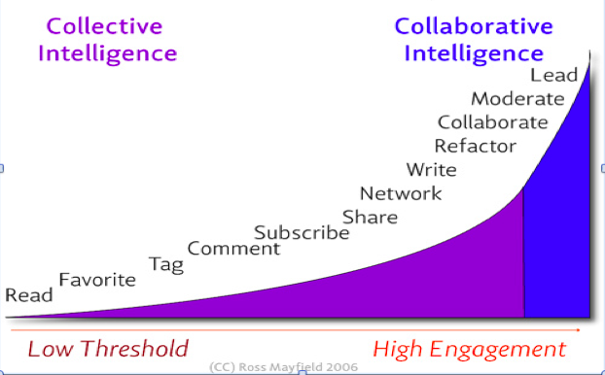
Power law of Participation
Notes:
This power law shows us that it takes a lot of engagement to go from being
a passive consumer of media to an active producer.
You need media skills. Therefore kids with few skills must learn more and the
kids with many skills must be challenged to learn others.
This is one of the reasons for producing the website : SmåP.dk/SmaaP.dk

Slide 18

Notes:
SmåP - or Small Productions – is an online tool consisting of self-instructing activities
= building blocks for an efficient media education. Each learning activity targets a specific
media skill resulting in a small media production. Here is a small video introduction.

Slide 19
Our experience
Starting a film school targeted at young people :
We made a pilot project – recorded it – showed it
Got the support from film makers, the industry, politicians, education system
Found a professional environment
Use film makers as teachers
Use professional methods, materials and equipment
Use digital learning tools
Provide the professionals with teaching materials/activities
Stick to our principles: Hands on and Stand up

